Slide 1








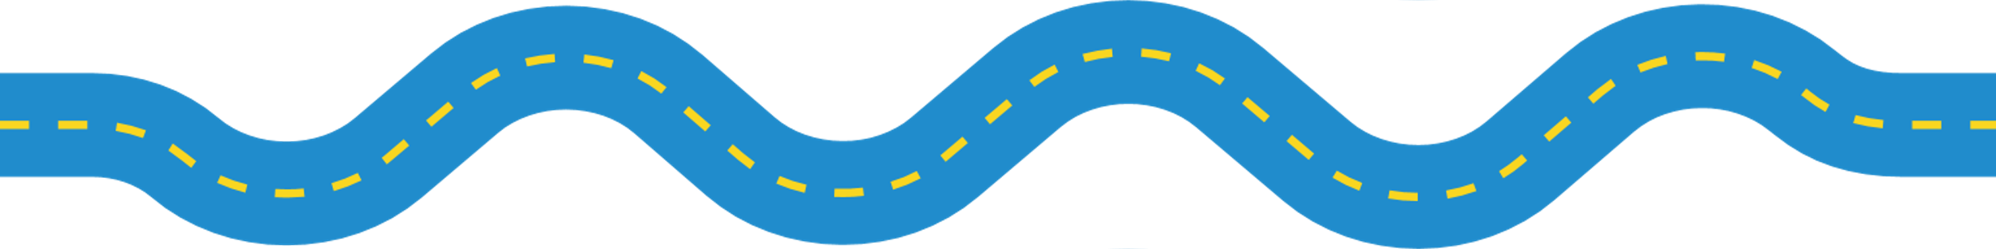


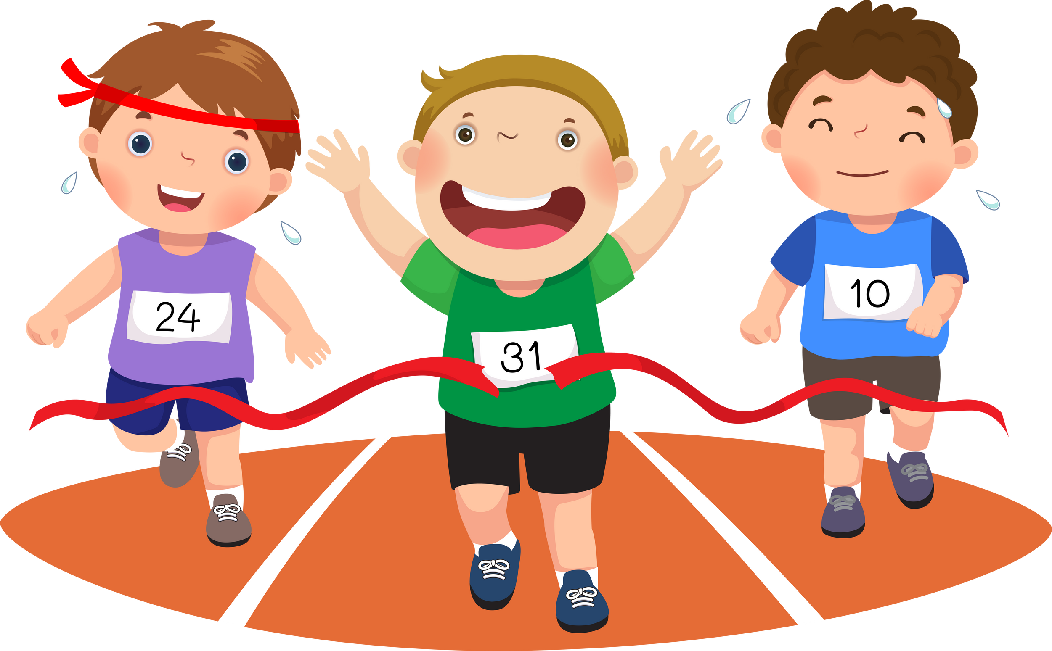

Year 3: Term 1 Snapshot
English
Maths
History
How did people transport things before the railway?
What impact did Brunel have on the railway?
How did the railways benefit Britain?
​
Gorilla
George’s Marvelous Medicine
Place value within 1,000
Addition and Subtraction
Key Dates
Home Learning
PE
Tuesday 2nd September:
First Day of School
Thursday 18th September: School photos
w/c 22nd September (TBC):
Visit to South Devon Railway
Reading as much as possible.
Practising weekly spellings.
Completing a creative task from the Home Learning Menu.
PE Lessons will be on a Monday for Year 3.
Please make sure your child is wearing School PE Kit.

Slide 2


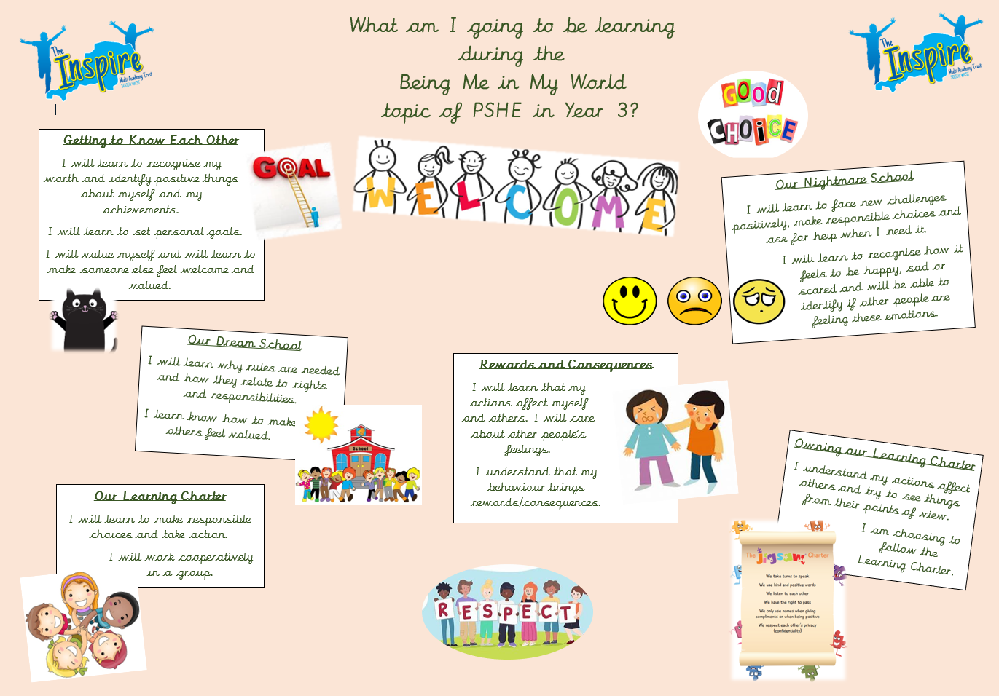

Year 3: Term 1 Snapshot
I

